Slide 1

Project Status
Algorithmic Trading with Deep Learning
Ritesh Kumar

Slide 2
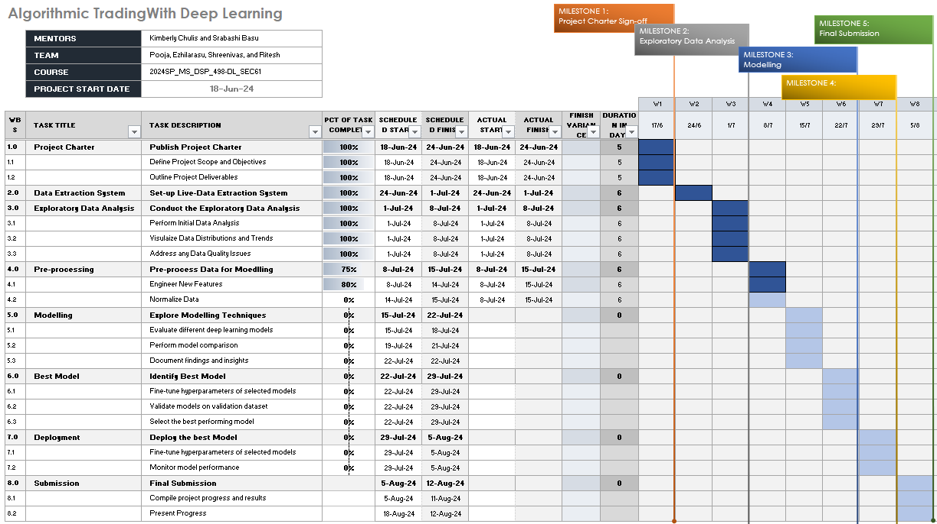

Slide 3



Project Status Overview
PROJECT CHARTER COMPLETED
DATA EXTRACTION SYSTEM IMPLEMENTED
EXPLORATORY DATA ANALYSIS PERFORMED
The project charter, which outlines the scope, objectives, and key stakeholders, has been finalized and approved.
The data extraction system, responsible for retrieving data from various sources, has been successfully set up and is operational.
Extensive exploratory data analysis has been conducted to gain insights into the data, identify trends, interactions and patterns.
THE PROJECT IS ON TRACK, WITH THE KEY MILESTONES OF THE PROJECT CHARTER, DATA EXTRACTION SYSTEM, AND EXPLORATORY DATA ANALYSIS COMPLETED AS OF JULY 9, 2024. THIS LAYS A STRONG FOUNDATION FOR THE NEXT PHASE OF THE PROJECT.

Slide 4



Project Status - Continued
PRE-PROCESSING TASKS
FEATURE ENGINEERING
DATA NORMALIZATION
Covers the various pre-processing steps, such as data cleaning, feature selection, and data normalization.
Creating new features from the raw data to improve the model's performance.
Covers the importance of data normalization and the techniques used to ensure the data is on a consistent scale.
THE PRE-PROCESSING TASKS, INCLUDING FEATURE ENGINEERING AND DATA NORMALIZATION, ARE CRUCIAL STEPS IN THE PROJECT'S PROGRESS. THESE STEPS ENSURE THE DATA IS PREPARED FOR THE SUBSEQUENT ALGORITHMIC TRADING MODEL DEVELOPMENT.

Slide 5



Risks and Issues
INTERNET OUTAGE INCIDENT
MITIGATION MEASURES
ABSENCE OF MAJOR RISKS
To prevent future disruptions, starting from 8-Jul-24, we have migrated our data collection process to Sagemaker Studio on AWS.
Confirms that there are no other major risks or issues identified at this time, and the project is progressing as planned with no significant concerns.
An internet outage occurred between 11:21 AM and 1:08 PM on July 3, 2024, resulting in a gap in data collection.
THE PROJECT TEAM HAS EFFECTIVELY ADDRESSED THE ISOLATED INTERNET OUTAGE INCIDENT AND IMPLEMENTED ROBUST MITIGATION MEASURES TO ENSURE THE STABILITY AND RELIABILITY OF THE TRADING PLATFORM. WITH NO OTHER MAJOR RISKS OR ISSUES IDENTIFIED, THE PROJECT IS WELL ON TRACK TO MEET ITS OBJECTIVES.

Slide 6




Accomplishments
COMPLETED DATA COLLECTION
FEATURE ENGINEERING
Gathered a comprehensive dataset of historical stock prices, trading volumes, and relevant market indicators to provide a solid foundation for the analysis.
Engineered a diverse set of features, including technical indicators, market sentiment, and macroeconomic factors, to capture the complexity of the financial markets.
EXPLORATORY DATA ANALYSIS
MIGRATION TO AWS
Performed extensive exploratory data analysis, identifying patterns, trends, and potential insights that will inform the subsequent model development.
To prevent future disruptions, starting from 8-Jul-24, we have migrated our data collection process to Sagemaker Studio on AWS.
THE SUCCESSFUL COMPLETION OF THE DATA COLLECTION AND EXPLORATORY DATA ANALYSIS PHASES LAYS A STRONG FOUNDATION FOR THE NEXT STEPS IN THE ALGORITHMIC TRADING PROJECT, SETTING THE STAGE FOR THE DEVELOPMENT AND OPTIMIZATION OF THE DEEP LEARNING MODEL.

Slide 7
Next Steps
PRE-PROCESSING
Clean and prepare the data, handle missing values, scale features, and split the data into training and validation sets.
MODELING
Experiment with different deep learning architectures such as recurrent neural networks (RNNs), long short-term memory (LSTMs), or convolutional neural networks (CNNs) to build the algorithmic trading model.
DOCUMENTATION
Thoroughly document the data preparation steps, model architecture, hyperparameter tuning, and evaluation metrics to ensure reproducibility and maintainability.
BEST MODEL SELECTION
Evaluate the performance of the trained models on the validation set and select the one that demonstrates the best predictive accuracy and profitability for the algorithmic trading task.
DEPLOYMENT
Package the selected model and integrate it into a production-ready system for live trading, ensuring seamless deployment and monitoring.

Slide 8
Thank You

